Slide 1
CURRENT CRAZE: NEWS WEB APP
Connecting you to the Current World

Slide 2
Current Craze: info
A News web application is an online platform that delivers upto date news and information from various sources. Users can access article and images and other media content, and stay informed about current events and topics of interest.

Slide 3
Languages used
JavaScript: JavaScript is used to implement features like live updates, interactive charts, and real-time commenting systems. This interactivity can engage users and keep them on the site longer.
HTML: HTML is the standard markup language for creating the structure and content of web pages.
CSS: CSS allows to control the visual presentation and styling of web content in news web application. CSS enables the customization of fonts, colors, layouts, and other visual elements to create an engaging user experience.

Slide 4
01
USING API
02
USING WEATHER AND FINANCE WIDGETS
TABLE OF CONTENTS
03
Using CSS to form card container
Gathering news from newsapi.org
widgets are used form weatherwidget.io and tradingview.com
Using cards news’s title, published date and description are showed

Slide 5


WEBAPP OVERVIEW
LOGO
CUTOMISED LOGO
WIDGETS
FINANCE AND WEATHER WIDGETS
IMAGES
NEWS RELEVANT IMAGES
CARDS CONTAINER
CARDS TO SHOW TITLE DESCRIPTION OF NEWS

Slide 6
WIDGETS USED: * FINANCE: TRADINGVIEW * WEATHER: WEATHER.IO

Slide 7
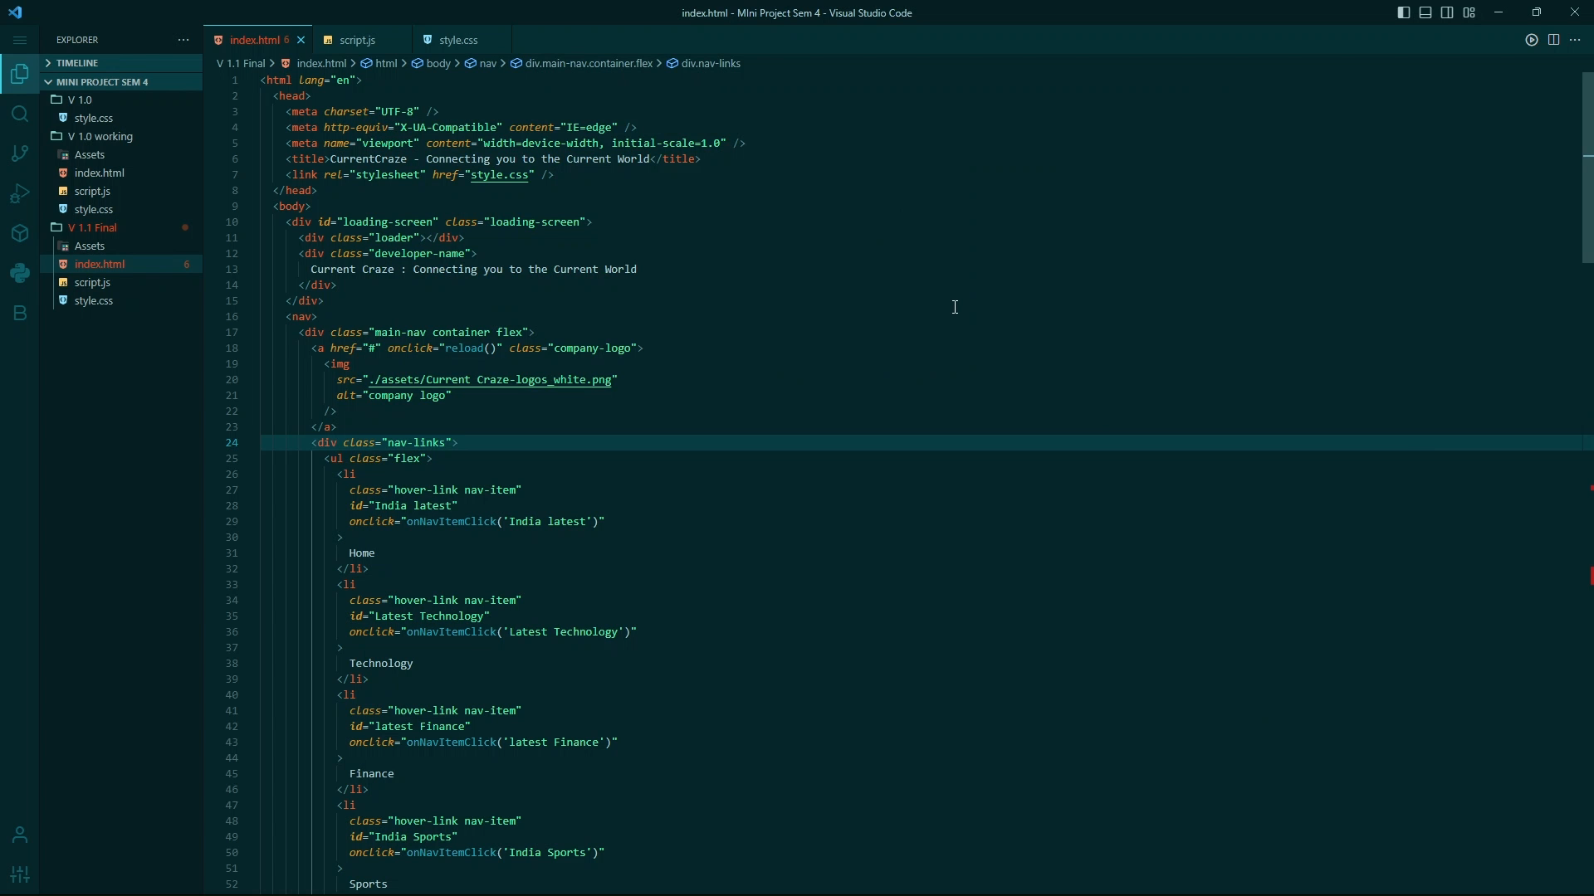
Working…

Slide 8
—SOMEONE FAMOUS
“This is a quote, words full of wisdom that someone important said and can make the reader get inspired”

Slide 9
SUBMITTED BY:
PRINCE KUMAR
RAJ GAURAV
AQUIB IQBAL
ADITYA KAMAT
21013440070
210134400
21013440017
210134400

